Slide 1
Can Stock Market Forecasters Forecast?
By Alfred Cowles 3rd
Presented by Yifei Xu

Slide 2
Agenda
Background information
Introduction of the paper
Efficiency of forecasts on individual stock prices
Efficiency of forecasts on the stock market trend
Statistical interpretations of results
Summary
My thoughts about this paper

Slide 3
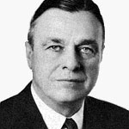
Author: Alfred Cowles 3rd
Alfred Cowles 3rd (1891-1984) graduated from Yale in 1913. He was an American economist, businessman, and founder of Cowles Commission. He was also a Fellow of the American Association for Advancement of Science, and a Fellow and Treasurer of the Econometric Society. Mr. Cowles’s primary concern in 1932 was to elevate economics into a more precise science using mathematical and statistical techniques.

Slide 4
Introduction
This paper presents results of analyses on stock market forecasts from 45 professional agencies.
First part: Forecasting the course of individual stock prices
Second Part: Forecasting the stock market according to the Dow Theory
Third Part: Stock market forecasts of financial publications

Slide 5
Forecasting the course of individual stock prices
Two groups of agencies:
16 leading financial services & 20 fire insurance companies
Time span:
4.5 years, ending July 1932, of forecast records from financial services
4 years, from 1928 to 1931 inclusive, of stock transaction records from fire insurance companies
Methods:
Record each week the buy or sale recommendations
Record each week the percentage gain or loss of each transaction as well as the stock market for the identical period
Every six months, compare the return generated by the recommendations to that of the stock market

Slide 6
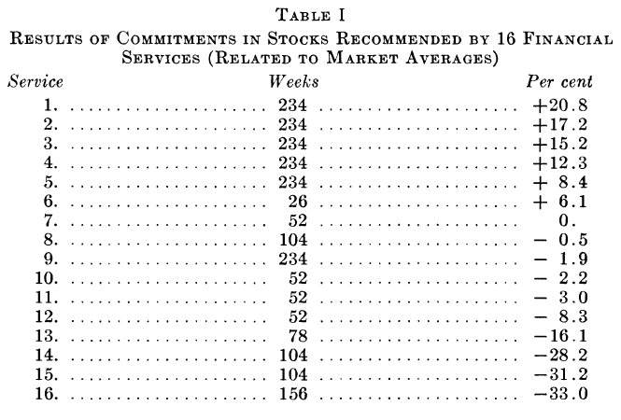
Forecasting the course of individual stock prices
Assumptions:
Drop a stock from the list six months after it was last recommended due to the tendency of financial services to emphasize on successful forecasts and ignore unsuccessful ones
Redistribution of fund in equal amounts among all stocks recommended every six months
Results:
Only 6 of the 16 financial services achieved any success.
The weighted average of annual effective rate of all services is -1.43%
According to probability tests, if a service is on the right side of the market, we should expect 0.8 service in 16 services to be as good as service 1. It implies that the return of service 1 cannot be definitely attributed to skill.

Slide 7
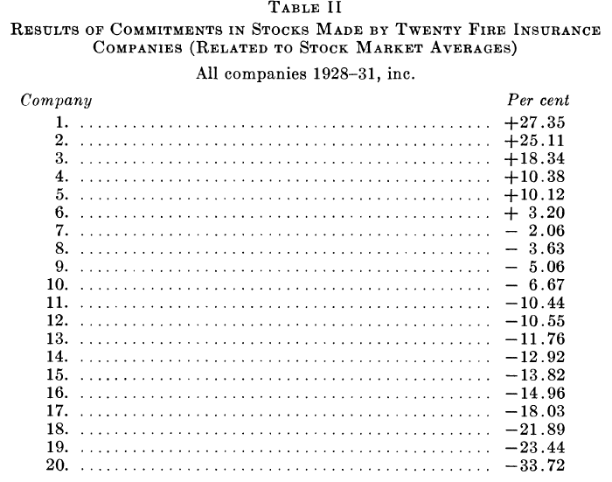
Forecasting the course of individual stock prices
Assumptions:
Only record actual purchases and sales made during the period of examination instead of the whole stock portfolio of each insurance company due to low turnover rate
Stock purchases were given equal weights
A stock is assumed to be sold 12 months after it was last purchased
Results:
Only 6 of the 20 companies achieved any success.
The average annual effective rate of all companies is -4.72%, while the average of annual effective rate of the market is 1.2%
A comparable result can be achieved through a purely random selection of stock.

Slide 8
What is the Dow Theory?
The Dow Theory is an approach to trading developed by Charles H. Dow.
It states that the market is in an upward trend if one of its averages (industrial or transportation) advances above a previous important high and is accompanied or followed by a similar advance in the other average.
The theory is predicated on the notion that the market discounts everything in a way consistent with the efficient markets hypothesis. Different market indices must confirm each other in terms of price action and volume patterns until trends reverse.

Slide 9
Forecasting the stock market according to the Dow Theory
Data source:
255 market forecasts of William Peter Hamilton(1867 – 1929), who was the fourth editor of the Wall Street Journal and a proponent of Dow Theory.
Time Span: 26 years
Assumptions:
Doubtful = abstained from trading
Bullish = long equal dollar amounts of the stocks included in the Dow Jones railroad and industrial average
Bearish = short equal dollar amounts of the stocks included in the Dow Jones railroad and industrial average, cover only when he became doubtful or bullish

Slide 10
Forecasting the stock market according to the Dow Theory
Results:
From December 1903 to December 1929, William Peter Hamilton earned an annual return of 12% on the Dow Jones industrial average, while the market showed an annual return of 15.5%
From December 1903 to December 1929, William Peter Hamilton earned an annual return of 5.7% on the Dow Jones railroad average, while the market showed an annual return of 7.7%
In 90 forecasts of Dow Jones industrial average, William Peter Hamilton made bullish forecasts 29 times, 16 of them were profitable and 13 were not. He made bearish forecasts 23 times, 10 of them were profitable and 13 were not. He advised 38 times to withdraw fund from stock market, 19 of them were profitable and 19 were not.
In 90 forecasts of Dow Jones railroad average, 41 of them were successful and 49 were not.

Slide 11
Stock market forecasts of financial publications
Time Span: From January 1, 1928, to June 1, 1932
Sample Size: More than 3300 forecasts
Market: Standard Statistics company index of 90 representative stocks
Assumptions:
There are 9 possible investment strategies: 100%, 87.5%, 75%, 62.5%, 50%, 37.5%, 25%, 12.5%, or 0%
The effective return = one of the voted percentage above * actual rate of return

Slide 12
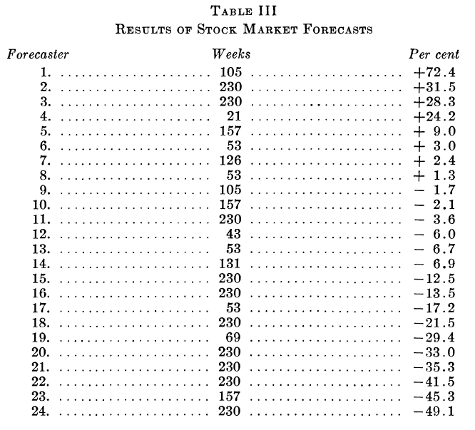
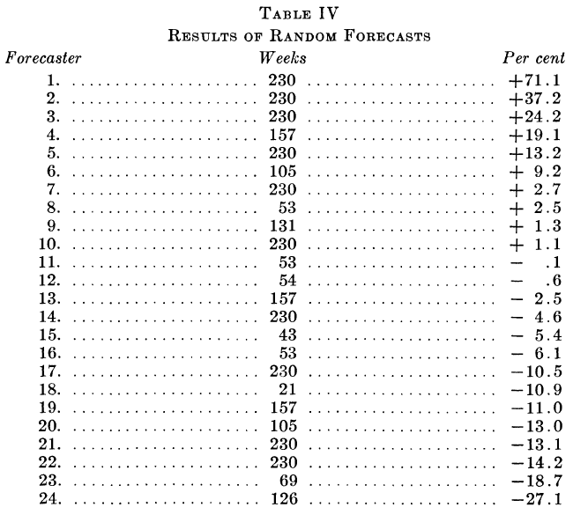
Stock market forecasts of financial publications
Only 1/3 of the forecasts achieved any success.

Slide 13
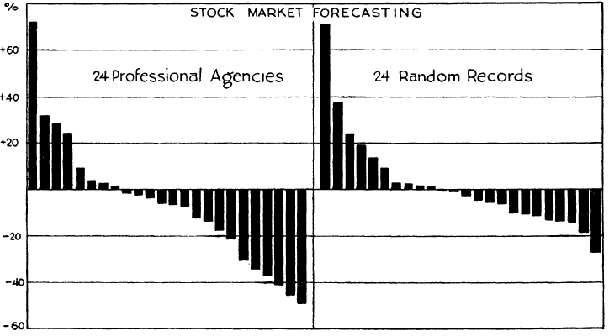
Stock market forecasts of financial publications
The extremer loss of the forecasters exceeds that of random records.

Slide 14
Summary
All of the attempts mentioned in forecasting the movement of both single stock price and stock market have been proved to be unsuccessful.

Slide 15
My thoughts
With the development of technology, there may be a small chance in the future that we can predict the stock market using AI and machine learning.

